Slide 1
Correlation
&
Regression

Slide 2
Correlation
Correlation analysis deals with association between two or more variables.
E.g.
The degree of relationship between the variables under consideration is measured through the correlation analysis.
The measure of correlation called the “ Correlation Coefficient” or “Correlation Index” summarizes in one figure the direction & degree of correlation
X | Y
10 | 15
12 | 20
15 | 22
18 | 25
20 | 37
X | Y
20 | 40
30 | 30
40 | 22
60 | 15
80 | 10

Slide 3
Types of Correlation
Positive Correlation
(Direct correlation)
Negative Correlation
(Inverse correlation)

Slide 4

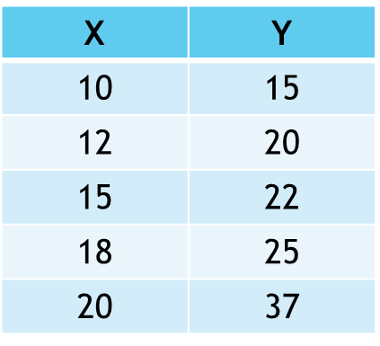
Positive Correlation:
X Y & X Y
Example: Height & Weight
Coefficient Value (r):
r : 0 to 1
X | Y
25 | 50
23 | 40
22 | 30
20 | 20
18 | 10

Slide 5

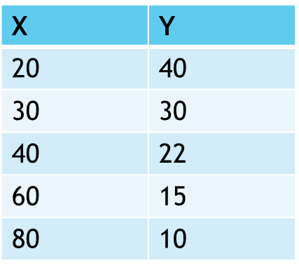
Negative Correlation
X Y & X Y
Example: Price & Demand
Coefficient Value (r):
r : -1 to 0
X | Y
35 | 30
30 | 32
26 | 34
24 | 36
20 | 40

Slide 6
Correlation Coefficient
r = 1 : Perfect Positive Correlation
r = -1 : Perfect Negative Correlation
r = 0 : No Correlation

Slide 7
Regression
Regression Analysis is the technique for measuring or estimating the relationship among variable
Regression Analysis provides estimate of values of the dependent variable from the values of the independent variable
The device used to accomplish this estimate procedure is the regression line
The regression line describe the average relationship existing between X & Y
X | Y
4 | 100
7 | 92
15 | 90
18 | 82
. . . . | . . . .
28 | 68

Slide 8
Difference:
Correlation Analysis | Regression Analysis
Correlation Coefficient is a measure of degree of covariability between x & y | Objective of Regression analysis is to study the nature of relationship between variables
In correlation analysis we cannot say that one variable is the cause & other the effect. | In regression analysis it is possible to study cause & effect relationship
In correlate on Analysis both rxy & ryx are symmetric (rxy=ryx) | In correlate on Analysis both rxy & ryx are not symmetric
Correlation Coefficient is independent of change of scale & origin. | Correlation Coefficient is independent of change of origin but not of scale.

Slide 9
Thank
YOU

